Slide 1
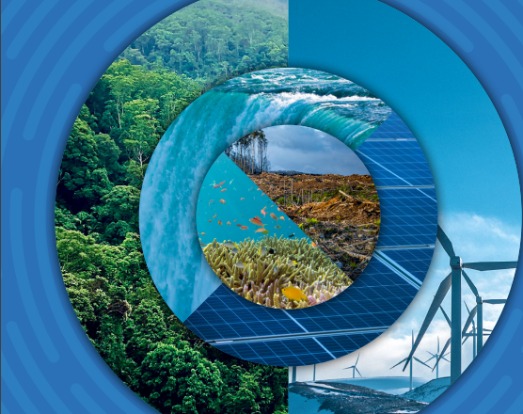
Estado Actual y Tendencias de la Fijación del Precio al Carbono Mayo 2023
Marcos Castro
Especialista Senior en Cambio Climático
Banco Mundial

Slide 2
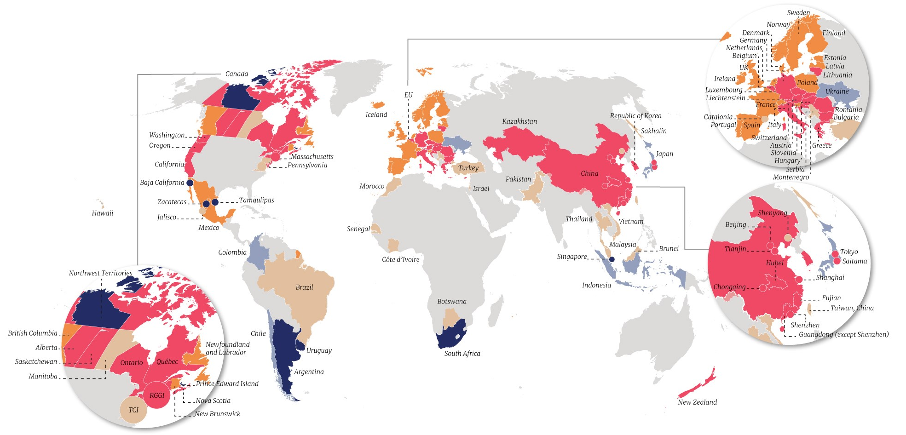
23% de las emisiones globales de GEI cubiertas
68 instrumentos (impuestos y sistemas de comercio de emisiones) en operación
Nuevos instrumentos en Uruguay y América del Norte (Oregón, New Brunswick, Ontario)
Nuevos instrumentos previstos en Indonesia, Austria, y Estado de Washington
Otros desarrollos incluyen mecanismos transfronterizos para la fijación del precio al carbono (e.g., CBAM)

Slide 3
Precios de los ‘permisos’ en los Sistemas de Comercio de Emisiones (ETS) alcanzan niveles récord
OMS declara emergencia de salud pública en respuesta a COVID-19
Nueva Zelanda elimina precio tope
Rusia invade Ucrania
SCE de UE
Precio del carbono
Caída del lunes negro (mercado de valores), 2011
Crisis financiera 2008
Reformas al SCE de la UE acordadas
UE acuerda objetivo de 55%
República de Corea propone un objetivo de emisiones más ambicioso
SCE de NZ
California Cap-and-Trade
SCE de Rep. de Corea
RGGI
Notes:
Record ETS prices were observed in the European Union (EU), California, New Zealand, and Republic of Korea, among other markets

Slide 4
Impuestos al carbono: nivel de tasas también en alza
Canadá
Suiza
Irlanda
Precio del carbono
Columbia Británica
Singapur
Sudáfrica
Letonia
Ucrania

Slide 5
… pero los precios se mantienen por debajo de los niveles necesarios
Impuesto al carbono
SCE
Precio del carbono
<4% de emisiones de GEI a nivel global están cubiertas por un precio del carbono dentro del rango que es necesario para 2030

Slide 6
Ingresos fiscales por carbono (tasas, subastas de permisos) aumentaron considerablemente
Impuesto al carbono
SCE
Los ingresos de SCEs superan por primera vez los ingresos de impuestos al carbono
Miles de millones
~USD 84 mil millones en 2021

Slide 7
Mercados de certificados de carbono
Artículo 6 del Acuerdo de Paris
Más acuerdos bilaterales
ITMOs
Fragmentación del mercado probablemente continuará

Slide 8
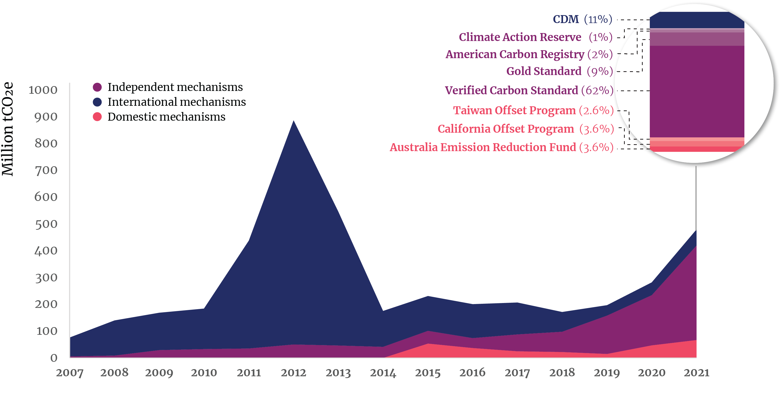
Los mercados de certificados de carbono crecen rápidamente
Mecanismos independientes
Mecanismos internacionales
Mecanismos domésticos
Millones tCO₂e
Emisión total de créditos aumentó 48% en 2021

Slide 9
Nuevos servicios financieros y tecnologías en los mercados de créditos de carbono
El rol de los actores financieros en los mercados de créditos de carbono ha crecido considerablemente
Los nuevos servicios y tecnologías incrementan oportunidades y riesgos
Se está generando un impulso para mejorar la integridad

Slide 10
A tener en cuenta…
Precio e ingresos
Instrumentos de precio al carbono implementados y en evolución
El rol de los mercados de carbono
Precios futuros de la energía

Slide 11
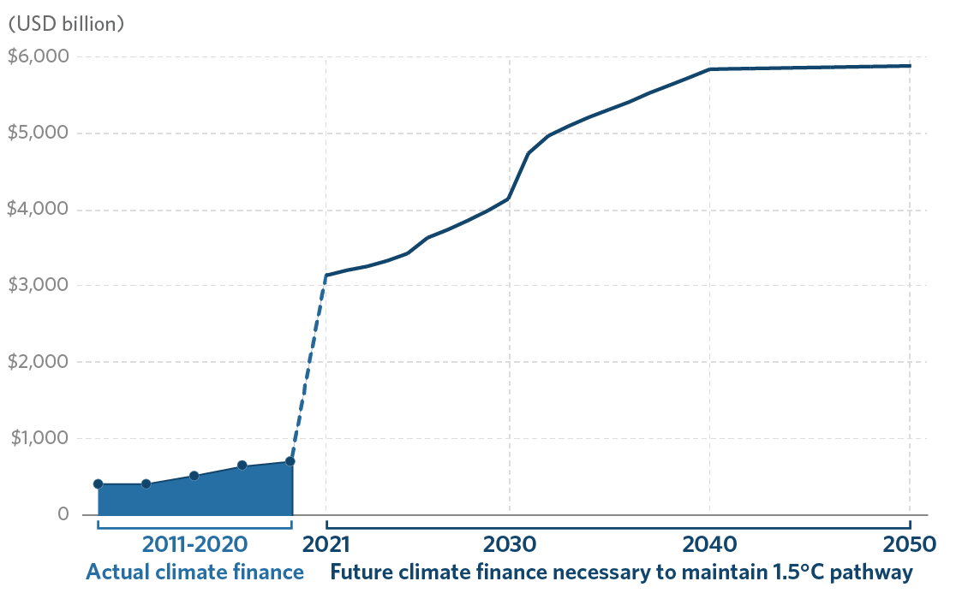
Financiación para acción climática debe aumentar
Se necesitan US$ 2.9 billones de financiación cada año hasta 2030 para limitar el calentamiento global a 1,5 °C
IPCC estima que se necesita de 4 a 7 veces más del financiamiento actual
El financiamiento climático será fundamental para catalizar las inversiones necesarias
Los mercados de carbono pueden ayudar

Slide 12
Financiación Climática y Mercados de Carbono: complementarios pero distintos
International Public Climate Finance
Other Climate Finance
Finance deployed through multilateral, bilateral and MDB systems
Other funding sources that provide capital for climate related investments
Dedicated Climate Finance
Concessional or grant finance with climate focus
Example: Grant funding from the Green Climate Fund for coastal zone resilience, Mitigation finance from Climate Investment Fund
Development Finance with Climate Co-Benefits
MDB lending with climate co-benefits
Example: World Bank loan for forest management
Private Finance
Commercially oriented investment in climate assets
Example: Investment in wind farm or solar power by private sector. IFC or MIGA can de-risk investment
Public Finance
Domestic government spending supporting climate goals
Example: State-owned utility builds a solar facility. World Bank can catalyze finance.
Result-based climate finance
Voluntary Carbon Markets
Compliance Carbon Markets
Notes:
Dedicated climate finance: $3-4B a year
Development finance with climate co-benefit: $50-70 B/ year
Other climate finance: ~500-600 B/ year

Slide 13
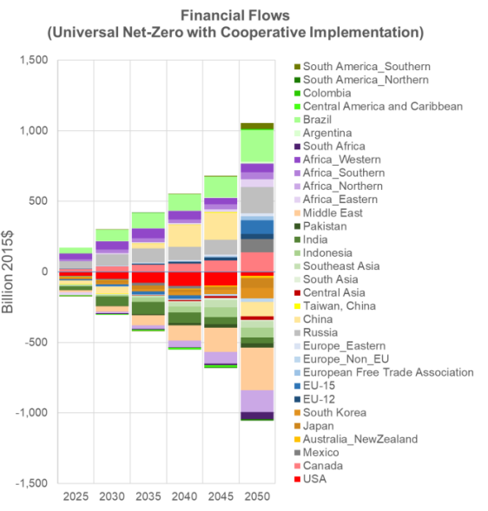
Se espera un crecimiento de los Mercados de Cumplimento bajo el Artículo 6 del Acuerdo de París
Los mercados de cumplimiento vinculados al Acuerdo de París pueden resultar en ahorros de costos de ~ US$300 mil millones/año en 2030 y reducir 5 GtCO₂ /año adicionales de emisiones de gases de efecto invernadero
Source: PNNL, University of Maryland, IETA

Slide 14
COP27 y Desarrollo de Mercados de Carbono
1
Avances en Artículo 6
For Article 6.2, COP27 text clarifies details, including the rules on how to track ITMOs through a registry, details on country’s Article 6 reporting reviews, and how parties should report the use of ITMO towards the achievement of NDCs.
Article 6.4 conclusion text provided the needed clarifications on the Clean Development Mechanism (CDM) transition and other implementation details, including the setting up of the Supervisory Board to define implementation details.
Primera transacción de ITMO entre Suiza y Ghana
While Article 6 remains to be fully finalized, Switzerland and Ghana have completed the first ever voluntary sale of ITMOs under Article 6.2. With this transaction, sustainable rice farming in Ghana will help Switzerland lower its national emissions, while giving Ghanaian farmers an extra revenue stream. The trade shows that countries do not need to wait for COP negotiations to end to act collaboratively.
Iniciativa Africana de Mercados de Carbono (ACMI)
Aims to produce 300 million carbon credits annually across the continent by 2030, and 1.5 billion credits annually by 2050.
The goal of the initiative is to unlock more financing for Africa’s energy transition – specifically, US$6 billion by 2030 and US$120 billion by 2050, all the while supporting over 110 million jobs by 2050.
Several African nations, including Kenya, Malawi, Gabon, Nigeria and Togo, joined the launch event for ACMI, which is supported by financiers such as Exchange Trading Group, Nando’s and Standard Chartered.
Acelerador de Transición Energética
U.S. Climate Envoy John Kerry made headlines early in the summit by announcing the Energy Transition Accelerator (ETA) – a public-private initiative to fund renewable energy projects through carbon offsets, with the purpose of accelerating the clean energy transition in developing countries.
2
3
4

Slide 15
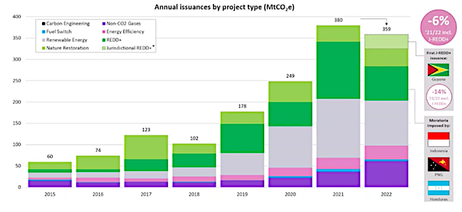
Mercado Voluntario de Carbono ha crecido más rápido en los últimos años
Mercado Voluntario de Carbono ha crecido
Se espera que este crecimiento continúe
Up to 100x
Commitment to date
NGFS scenario
jREDD+
TSVCM survey
NGFS “immediate action” 1.5ºC pathway with CO₂ removal
REDD+
US$ 10-40 billion by 2030
~15x
RETs
Source: Trove Research,2023
Source: Allied Crowds, 2020; UCL; Boston Consulting Group, 2023, Liebreich Associates, Mckinsey Sustainability.

Slide 16
Desafío clave para el crecimiento del Mercado Voluntario de Carbono: riesgos de reputación para las empresas
A high-integrity VCM is a key complementary tool to reduce and remove emissions above and beyond what would otherwise be possible and to channel finance towards low carbon, climate resilient development.
VCM integrity is essential to unlock private sector capital.
All stakeholders need assurance that the use of carbon credits strengthens – rather than undermines – global climate action.
Key Concerns of Responsibility of Corporates
Clarity & Standards for Corporates
Matching Demand and Supply Integrity for Corporates
Greenwashing
Prioritization of reduction and avoidance of corporates’ own emissions before compensating residual emissions
Three main elements: Transparent net-zero or decarbonization plan with monitorable interim targets: action plan for avoiding, reducing, compensating emissions)
A carbon credit procurement strategy
An operating model for using carbon credits
Investors and corporates cannot effectively allocate capital without clarity on the acceptable use of carbon credits for voluntary net-zero/ decarbonization targets
Voluntary Carbon Markets Integrity (VCMI) initiative provisional Claims Code of Practice:
Clear guidance about the use of carbon credits for corporate claims
Carbon credits can be used for VCMI Claims – Gold, Silver, and Bronze – and represent contributions to the collective global effort to transition to net zero emissions.
The Integrity Council for the Voluntary Carbon Market (ICVCM) seeks to build supply side integrity of carbon markets to scale-up.
The Core Carbon Principles and Assessment Framework developed will set new threshold standards for high-quality carbon credits and define which carbon-crediting programs and methodology are eligible.
There is also the need to settle the application of Paris Agreement accounting framework to the VCM
This helps match demand and supply integrity for carbon markets, permitting clarity to corporates and investors.

Slide 17
Tendencias en los mercados global de carbono y el rol del Banco Mundial
Voluntary carbon markets are growing faster than compliance markets
Compliance markets will grow to catch-up with (and overtake) voluntary markets
Global emissions are rising, and carbon markets are not growing fast enough
Growth of voluntary markets far exceeds compliance markets; they have funneled more than EUR5 billion over the last 20 years
The voluntary market reached its maximum since 2010 and crossed US$1 billion in (2022) for the first time and is expected to rapidly grow
Demand is growing - market is expected to be supply constrained in the coming years
The demand for carbon credits from Nature-based Solutions (NbS) projects is growing fastest
Article 6 can help countries meet their NDC goals in a quicker and cheaper way with US$300 billion/year savings
55+ countries’ NDC confirm their interest in utilizing international market mechanisms and there are an increasing number of Article 6 pilots
It is estimated that airlines will need to offset ~0.5 – 3.0 billion tons of CO2 from 2021—2035 to comply with CORSIA
WBG – though scale-up of results-based carbon financing and related de-risking financing and guarantee products – can accelerate climate action and WBG carbon funds, particularly SCALE, can catalyze further growth in supply-constrained carbon markets
IFC and MIGA can work directly with the private sector – and MIGA guarantees can be deployed to de-risk private sector investments
Capacity building and developing the needed infrastructure (e.g., PMI, Climate Warehouse, etc.) can play an important role in creating carbon market at scale

Slide 18
The Voluntary and Compliance carbon markets introduce carbon credit risks & considerations that World Bank Group can address
The Article 6 rulebook clarifies that host countries have the right to determine what emissions reductions may be transferred to other countries or entities, via an “Authorization” process – creating “Internationally Transferred Mitigation Outcomes” (ITMOs)
Investor risks:
Complex process to create carbon credits, low market liquidity, scarce financing, inadequate risk management framework, et. etc..
Change in regulations and policies impacting rights to carbon credits and ability to export.
Authorization for Corresponding Adjustment obtained and later revoked by host government
World Bank activities:
Building for a transparent market with effective institutions (e.g., PMI) and efficient infrastructure (e.g., Climate Warehouse). Catalyzing and pooling public sector capital, e.g., SCALE. New methodologies for e.g. Just Energy Transition and new approaches, e.g., REDD+
Country A
Host Government
Country B
Buying Country
Carbon project
Investor / Purchaser
IFC products:
Finding right partners to invest. Creating financial products (Carbon Delivery Guarantee to mitigate project and country risk). Catalyzing and pooling private capital
Government
Developer
Carbon offset sale
Carbon offsets
LOA with commitment to apply C.A.s
MIGA Coverage:
“Breach of Contract” guarantees to protect Investors against losses where “Letter of Authorization” terms may be breached, including rights to carbon and/or accompanying “Corresponding Adjustments”
Guarantees can be provided to the Developer, Investor or Credit purchaser, depending on where the Investment is “at risk”
Investment
Debt/equity prepayment for carbon credit
Notes:
Technical assistance, development of policies and institutions and cross-country learning
Learning-by-doing though WBG lending and Carbon Funds
Developing the market infrastructure and new products like guarantees, carbon bonds

Slide 19
Conclusiones
El financiamiento climático debe crecer rápidamente para abordar el desafío climático; los mercados de carbono pueden ayudar.
El riesgo reputacional es el desafío clave para el crecimiento de los mercados de carbono y el flujo de capital privado.
Los riesgos clave se pueden manejar aumentando la integridad, pero esto puede resultar en la complejidad de las reglas del mercado de carbono.
Los emisores de estándares, los gobiernos, y las instituciones multilaterales tienen un papel importante que desempeñar para ayudar a aumentar los mercados de carbono para el capital privado.

Slide 20
Gracias
Marcos Castro
Especialista Senior en Cambio Climático
Banco Mundial

